Slide 1
Agenda
Architecting in the cloud
IAM - security
VPC and networks
EC2
Autoscaling (scaling up, scaling out)
Terraform: basic networking
Terraform: EC2, scaling groups
Roles
Alerts and scaling triggers

Slide 2
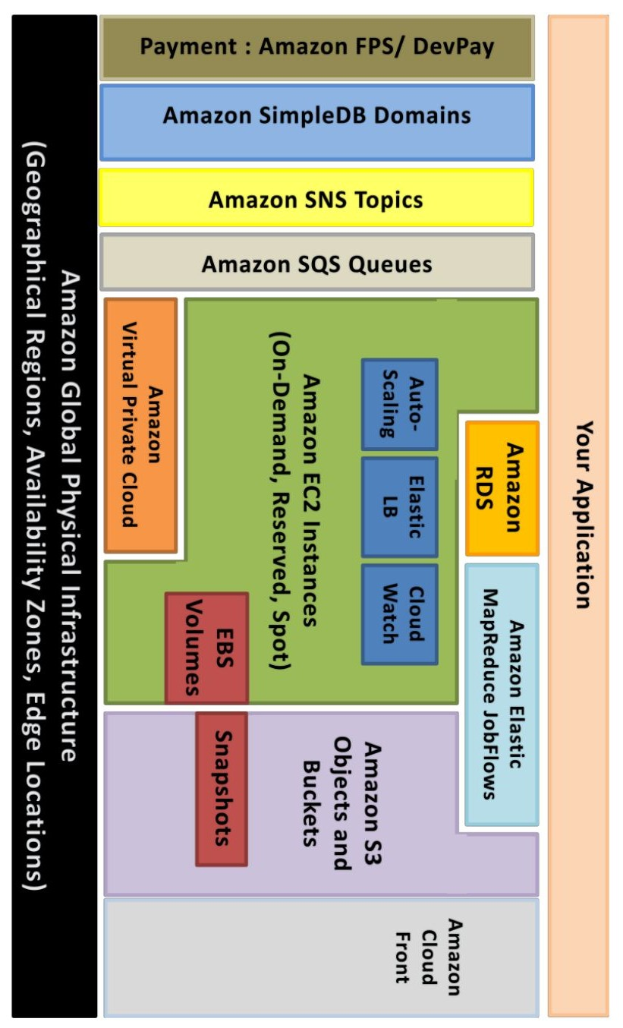
Source: unknown :(
AWS architecting

Slide 3
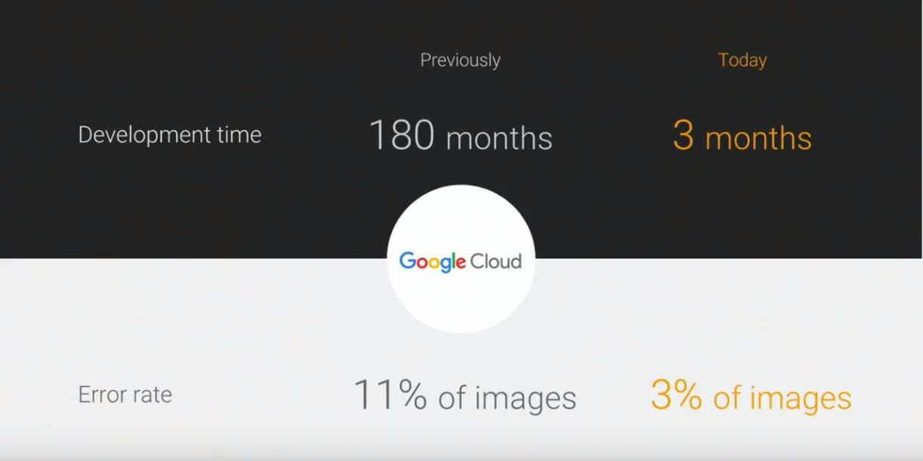
AWS (cloud) architecting
Source: unknown :(

Slide 4
IAM - access control
Identities
ARNs
Users
Groups
Roles
Resources
arn:aws:iam::account-ID-without-hyphens:user/Richard
arn:aws:s3:::my_corporate_bucket/exampleobject.png
arn:aws:iam::aws:policy/ReadOnlyAccess
arn:aws:autoscaling:region:account-id:scalingPolicy:policyid:auto ScalingGroupName/groupfriendlyname:policyName/policyfriendl yname
IAM Policy Generator: https://awspolicygen.s3.amazonaws.com/policygen. html
arn:partition:service:region:account-id:resource
arn:partition:service:region:account-id:resourcetype/resource

Slide 5
IAM - examples
{
"Version": "2012-10-17",
"Statement": [
{
"Effect": "Allow", "Action": [
"ec2:AttachVolume", "ec2:DetachVolume"
],
"Resource": [
"arn:aws:ec2:*:*:volume/*", "arn:aws:ec2:*:*:instance/*"
],
"Condition": { "ArnEquals":
{"ec2:SourceInstanceARN": "arn:aws:ec2:*:*:instance/<INSTANCE-ID>"}
}
}
]
}
{
"Version": "2012-10-17",
"Statement": { "Effect": "Allow", "Action":
"<SERVICE-NAME>:<ACTION-NAME>",
"Resource": "*", "Condition": {
"DateGreaterThan":
{"aws:CurrentTime": "2017-07-01T00:00:00Z"},
"DateLessThan": {"aws:CurrentTime": "2017-12-31T23:59:59Z"}
}
}
}

Slide 6
EC2 - scaling applications using VMs
EC2 LaunchConfiguration
EC2 LaunchTemplate
Single EC2 instance
Autoscaling Group
Load Balancers (ELB, ALB)
Target Group

Slide 7
ElasticBeanstalk
PaaS solution
Pre-configured environments
Docker possible
docker-compose not, but there’s an alternative
CloudFormation in the backend

Slide 8
ECS, also EKS (Kubernetes!)
Cluster managing containers for you
vCPU and memory reservation
More complex scaling (dockers + EC2 instances)
Generates higher costs if used incorrectly
Restarts services for you
Also kills, if service is trying to use to much resources
You still need to manage your EC2 instances inside the cluster (system updates, agent updates)

Slide 9
ECS Fargate
You don’t manage EC2 instances
Can’t mount persistent data volume
… well, you can, but it’ll be ephemeral volume (nonpersistent)
See: https://docs.aws.amazon.com/AmazonEC S/latest/developerguide/fargate-task-stora ge.html

Slide 10
Docker
Single process
No logs inside container
No IP address for container
Small images
Use Dockerfile or Packer
NO security credentials in container
… but put your code in there
Don’t use “latest” tag
Don’t run as root user
Stateless services - no dependencies across containers
FROM ubuntu:18.04
RUN apt-get update && \
apt-get -y upgrade && \ DEBIAN_FRONTEND=noninteractive apt-get -y install \ apache2 php7.2 php7.2-mysql \
libapache2-mod-php7.2 curl lynx EXPOSE 80
ENTRYPOINT ["/bin/sh"]
CMD ["/usr/sbin/apache2ctl", "-D", "FOREGROUND"]

Slide 11
Route53 - DNS
ALIAS != CNAME
strtolower()
Can act as a load balancer
Implements health checks
Zone can be removed after deleting all records
Public
Private (non-routable, second address in available pool)

Slide 12
S3 - object storage
Eventually consistent
Easy to use
Can be attached to VPC
Can be encrypted (KMS)
Versioning available
Replication
Can serve static pages (Vue, React, Angular)

Slide 13
AWS limits
Every service have set some limits (eg. number of EC2 instances) - very important to think ahead demand - show
Limits for LB naming, services naming (eg. Lambdas name) - different for every service (!) - 74, 128, 512 characters
API rate limiting
Hard to predict cost of running services

Slide 14
Before we go to Terraform - CloudFormation
Many services using it in the backend
There is no state file
Automatic rollbacks (should anything fail)
Sometimes rollback fail
There can be multiple stacks that depend on each other
It’s YAML or JSON, basically
Hard to read (example)
One can use DSL to simplify things:
Lono
Troposphere (Python)
SparkleFormation
A big no-no:
“When building CloudFormation templates, I’ve seen engineers search the internet, find an example CloudFormation template that is closed to what they are looking for, modify it ever so slightly so it works for their business use case, and then run with it.”
Source:
https://medium.com/boltops/why-generate-cloudformation-templates
-with-lono-65b8ea5eb87d

Slide 15

CloudFormation best practices book

Slide 16
Terraform - how it works
Have a state file
Different “providers” (like AWS, GCP)
NOT multicloud - you still need different code for each provider
It has own markup language (HCL)
You define resources and dependencies between them
Can group resources into “modules”
Have “workspaces” to switch between environments
No rollback - it stops should anything fail
Some “dry-run” - plan
provider "aws" {
region = "eu-central-1"
}

Slide 17
Terraform - state file
local file
file in S3 bucket
Atlas / Terraform Enterprise
etcd
Consul
Artifactory
http
...
Need to take care of:
state versioning
state locking
terraform {
backend "local" {
path = "state/terraform.tfstate"
}
}

Slide 18
Terraform - let’s install!
AWSCLI
https://terraform.io (0.11.x)
$ export AWS_PROFILE=blah
$ export PATH=$PATH:/path/to/terraform
$ terraform init
$ terraform plan
$ terraform fmt
$ terraform apply

Slide 19

Terraform - VPC and basic subnets
Multi AZ
Public and private subnets
NAT gateway
Internet gateway
Endpoints
Route tables
Network ACLs
https://randops.org/2016/11/29/quick-vpc-reference-configuration-for-scenario-2/

Slide 20
Terraform - NAT gateways, internet gateways
Internet gateway connected to a VPC
NAT gateways in a public network
Route tables must contain IGW and NAT GW

Slide 21
Terraform - basic EC2 instance
Single EC2 instance in a public subnet
t2.micro
SSH open
Must create SSH key in AWS
resource "aws_instance" "ssh_host" {
ami = "ami-0bdf93799014acdc4" instance_type = "t2.micro"
key_name = "${aws_key_pair.admin.key_name}" subnet_id = "${aws_subnet.public.id}"
vpc_security_group_ids = [ "${aws_security_group.allow_ssh.id}", "${aws_security_group.allow_all_outbound.id}",
]
tags {
Name = "SSH bastion"
}
}

Slide 22
Terraform - EC2 (auto)scaling
Launch configuration
Autoscaling group
Load balancer (ELB)
EC2 in a private subnet
LB in a public subnet (public)
CloudWatch setup:
EC2 instance role
CloudWatch metrics sent from EC2 using cron job
Alerts (high/low)
Scale strategy

Slide 23
VPC and subnets
resource "aws_vpc" "main" { cidr_block = "10.100.0.0/16" tags {
Name = "Terraform main VPC"
}
}
resource "aws_subnet" "public_a" {
vpc_id "${aws_vpc.main.id}"
cidr_block
=
= "10.100.1.0/24"
map_public_ip_on_launch = "true" availability_zone = "eu-central-1a" tags {
Name = "Terraform main VPC, public subnet zone A"
}
}

Slide 24
Internet Gateway (public subnets) and route table
resource "aws_internet_gateway" "default" { vpc_id = "${aws_vpc.main.id}"
tags {
Name = "Terraform internet gateway"
}
}
resource "aws_route_table" "public" { vpc_id = "${aws_vpc.main.id}"
tags {
Name = "Public route table"
}
}
resource "aws_route_table_association" "public_a" {
resource "aws_route" "public_internet_gateway" {
route_table_id = "${aws_route_table.public.id}"
destination_cidr_block = "0.0.0.0/0"
subnet_id = "${aws_subnet.public_a.id}"
route_table_id = "${aws_route_table.public.id}"
}
gateway_id =
"${aws_internet_gateway.default.id}"
}

Slide 25
NAT gateway and private subnets
resource "aws_subnet" "private_a" { vpc_id = "${aws_vpc.main.id}" cidr_block = "10.100.10.0/24" map_public_ip_on_launch = false availability_zone = "eu-central-1a"
tags {
Name = "Terraform main VPC, private subnet zone A"
}
}
resource "aws_nat_gateway" "natgw_a" { allocation_id =
"${element(aws_eip.nateip.*.id, 0)}" subnet_id = "${aws_subnet.public_a.id}" depends_on =
["aws_internet_gateway.default"]
}

Slide 26
EC2 instance, security group, ssh key (bastion host)
resource "aws_security_group" "allow_ssh" { name = "allow_ssh"
resource "aws_key_pair" "admin" { key_name = "admin-key"
description = "Allow inbound SSH traffic"
public_key = "${var.ssh_key}"
vpc_id ingress {
from_port to_port protocol
= "${aws_vpc.main.id}"
}
resource "aws_instance" "ssh_host" {
= 22
= 22
= "tcp"
ami = "ami-0bdf93799014acdc4" instance_type = "t2.micro"
key_name = "${aws_key_pair.admin.key_name}" subnet_id = "${aws_subnet.public_a.id}" vpc_security_group_ids = [
"${aws_security_group.allow_ssh.id}", "${aws_security_group.allow_all_outbound.id}",
]
tags {
Name = "SSH bastion"
}
cidr_blocks = ["0.0.0.0/0"]
}
egress { from_port = 0
to_port = 0
protocol = "-1"
}
cidr_blocks = ["0.0.0.0/0"]
}
}

Slide 27
How autoscaling works?
Launch Configuration / Launch Template
Autoscaling group
Autoscaling policy
Metrics
Alarms and alarm actions

Slide 28
Launch configuration
resource "aws_launch_configuration" "as_conf" { image_id = "${data.aws_ami.ubuntu.id}" instance_type = "${var.instance_type}"
key_name = "${aws_key_pair.admin.key_name}" user_data = "${data.template_file.init.rendered}"
security_groups = [ "${aws_security_group.http_server_public.id}", "${aws_security_group.allow_ssh_ip.id}", "${aws_security_group.allow_all_outbound.id}",
]
iam_instance_profile = "${aws_iam_instance_profile.ec2_default.name}" associate_public_ip_address = "${var.associate_public_ip_address}"
}

Slide 29
Autoscaling group
resource "aws_autoscaling_group" "application" { name = "ASG"
launch_configuration = "${aws_launch_configuration.as_conf.name}" vpc_zone_identifier = [
"${aws_subnet.private_a.id}", "${aws_subnet.private_b.id}", "${aws_subnet.private_c.id}"
]
min_size = "${var.min_size}" max_size = "${var.max_size}"
load_balancers = ["${aws_elb.default-elb.name}"] termination_policies = ["OldestInstance"]
tag {
key value
= "Name"
= "EC2-sample-service"
propagate_at_launch = true
}
}

Slide 30
Autoscaling policy
resource "aws_autoscaling_policy" "scale_up" {
resource "aws_autoscaling_policy" "scale_down" {
name scaling_adjustment adjustment_type
"ChangeInCapacity" cooldown
= "scale-up"
= 1
=
name scaling_adjustment adjustment_type
"ChangeInCapacity" cooldown
= "scale-down"
= -1
=
= 120
= 120
autoscaling_group_name = "${aws_autoscaling_group.application.name
}"
}
autoscaling_group_name = "${aws_autoscaling_group.application.name
}"
}

Slide 31
Metric and alarm action
resource "aws_cloudwatch_metric_alarm" "cpu_utilization_high" { alarm_name = "cpu-utilization"
comparison_operator = "GreaterThanOrEqualToThreshold"
evaluation_periods metric_name namespace
period statistic threshold
= "2"
= "CPUUtilization"
= "AWS/EC2"
= "60"
= "Average"
= "80"
dimensions {
AutoScalingGroupName = "${aws_autoscaling_group.application.name}"
}
alarm_description = "CPU Utilization high"
alarm_actions = ["${aws_autoscaling_policy.scale_up.arn}"]
}

Slide 32
Setting up a basic server in autoscaling group
For a service we need:
Launch Configuration / Launch Template
Autoscaling group
Autoscaling policy
Autoscaling:
Remember metrics must be sent by the EC2 instance to CloudWatch
There are alerts for “high” (scaling up) and “low” (scaling down)

Slide 33
Side quest: Let’s develop a service
Python 3.x
Have /health URI
Automatically deployed!
Need an S3 bucket for deployment
Launch configuration should deploy “latest” build
Remember IAM role to allow EC2 access the S3 bucket
You need AWSCLI on EC2 instance
ELB in public subnet(s)
EC2 in private subnet(s)
Autoscaling:
Remember metrics must be sent by the EC2 instance to CloudWatch
There are alerts for “high” (scaling up) and “low” (scaling down)

Slide 34
See you tomorrow! :-)

Slide 35
Three days doing stuff
Day 1
Day 3
AWS: networks, scaling, automation Terraform - howto
EC2, (auto)scaling
Load balancing (ELB, ALB)
Dockery, ECS - continue Configuration management Hashicorp Vault
Databases (RDS, ElastiCache, ...) AWS Lambda
Day 2
EC2, (auto)scaling CI/CD
Monitoring Docker ECS cluster

Slide 36
Agenda
Finishing up EC2 autoscaling
Let’s talk about Docker antipatterns
ECS cluster intro
Monitoring (Servers, Applications, Logs)
Continuous everything (CI/CD)
Terraform: code structure
Terraform: ECS cluster + services with autoscaling

Slide 37
EC2 autoscaling - continue!
Launch configuration
Autoscaling group
Load balancer (ELB)
EC2 in a private subnet
LB in a public subnet (public)
CloudWatch setup:
EC2 instance role
CloudWatch metrics sent from EC2 using cron job
Alerts (high/low)
Scale strategy

Slide 38
Docker
Single process
No logs inside container
No IP address for container
Small images
Use Dockerfile or Packer
NO security credentials in container
… but put your code in there
Don’t use “latest” tag
Don’t run as root user
Stateless services - no dependencies across containers

Slide 39
ECS
Cluster managing containers for you
vCPU and memory reservation
More complex scaling (dockers + EC2 instances)
Generates higher costs if used incorrectly
Restarts services for you
Also kills, if service is trying to use too much resources
You still need to manage your EC2 instances inside the cluster (system updates, agent updates)

Slide 40
Monitoring
From Amazon:
External:
CloudWatch
X-Ray (need code alterations, APM)
ElasticSearch (logs, SaaS)
CloudTrail (logs)
Datadog (metrics, APM, logs)
NewRelic
Ruxit
...

Slide 41
CI/CD
Continuous Integration
“practice of merging all developer working copies to a shared mainline several times a day”
- Wikipedia
Continuous Deployment
“software engineering approach in which software functionalities are delivered frequently through automated deployments” - also Wikipedia
Continuous Delivery
“making sure the software checked in on the mainline is always in a state that can be deployed to users and makes the actual deployment process very rapid” - Wikipedia

Slide 42
What that means?

Slide 43
Terraform code structure
.
└── terraform
├── accounts
Example:
https://github.com/TechnologyMinimalists/terraform-skeleton
│ | ├── | bootstrap
│ | │ | └── tfstate
│ | └── | main.tld
│ |  | └── eu-west-1
├── bin
└── modules

Slide 44
Jenkins - Jenkinsfile example
node("master") {
stage("Prep") {
deleteDir() // Clean up the workspace checkout scm
withCredentials([file(credentialsId: 'tfvars', variable: 'tfvars')]) { sh "cp $tfvars terraform.tfvars"
}
sh "terraform init --get=true"
}
stage("Plan") {
sh "terraform plan -out=plan.out -no-color"
}
if (env.BRANCH_NAME == "master") { stage("Apply") {
input 'Do you want to apply this plan?' sh "terraform apply -no-color plan.out"
}
}
}

Slide 45
ECS + 1-2 services
Let’s use a module to set up cluster with autoscaling
Reuse module for task definition
Reuse code of Python app we created
ELB and ALB - differences and why using ALB?
Where to keep your images? (Docker HUB, ECR)

Slide 46
Terraform modules
There are community modules
https://registry.terraform.io/
https://github.com/terraform-community-modules
Modules take inputs (variables) and generate outputs that could be used in other code

Slide 47
More on modules
ECS cluster
module "ecs-cluster" {
source = "azavea/ecs-cluster/aws" version = "2.0.0"
vpc_id = "${aws_vpc.main.id}" instance_type = "t2.small"
key_name = "blah" root_block_device_type = "gp2" root_block_device_size = "10"
health_check_grace_period = "600"
It’s worth to invest time to prepare modules tailored to your needs, but there are great ones ready to use
It’s going to take time to understand how module works
… but it’ll be shorter than creating your own
Not everything should be a module (do NOT securityGroupModuleFactory)
Group important things together
desired_capacity min_size max_size
enabled_metrics = [...] private_subnet_ids = [...]
= "1"
= "0"
= "2"
project = "Something" environment = "Staging" lookup_latest_ami = "true"
}

Slide 48
ECS cluster
IAM Role for EC2 instances
Use ECS-optimized instances (Amazon Linux)
IAM Role for Services
VPC and networking
ECR for keeping home-baked images (optional)
Aggregated metrics for “group”
CloudWatch log group for logs (optional)

Slide 49
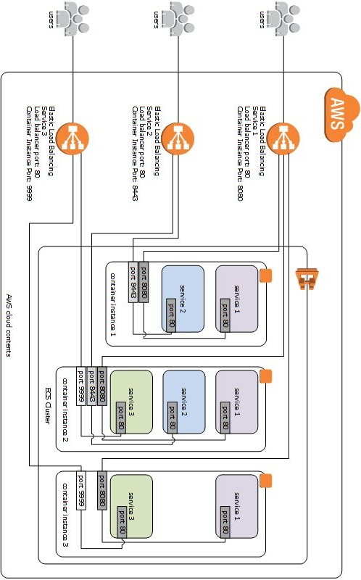
Source: https://stackoverflow.com/questions/36057445/several-amazon-ecs-tasks-on-the-same-instance-host

Slide 50
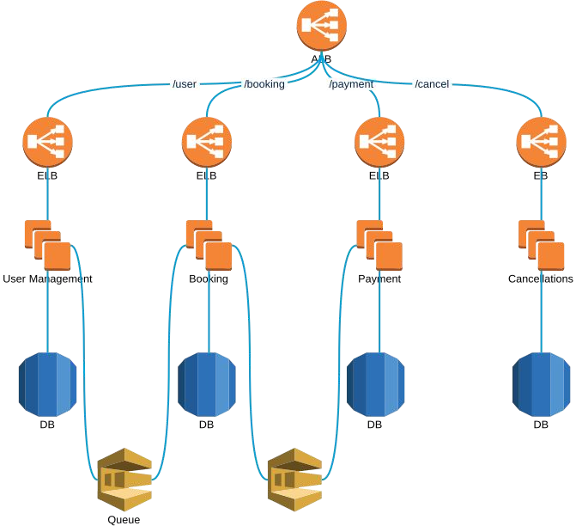

Slide 51
ECS task definition
resource "aws_ecs_task_definition" "main" {
[{
family container_definitions task_role_arn network_mode
cpu memory
= "some-name"
= "${var.task_definition}"
= "${var.task_role_arn}"
= "${var.task_network_mode}"
= "${var.task_cpu}"
= "${var.task_memory}"
"environment": [{
"name": "SECRET",
"value": "KEY"
}],
"essential": true, "memoryReservation": 128,
"cpu": 10,
"image": "nginx:latest",
"name": "nginx", "portMappings": [
{
"hostPort": 80, "protocol": "tcp", "containerPort": 80
}
]
}
requires_compatibilities = ["service_launch_type"] execution_role_arn = execution_role_arn
}
https://github.com/TechnologyMinimalists/aws-containers
-task-definitions
}]

Slide 52
ECS - service
resource "aws_ecs_service" "awsvpc_alb" {
name cluster
= "service_name"
= "ecs_cluster_id"
task_definition = "aws_ecs_task_definition" desired_count = "1"
load_balancer = {
target_group_arn = "${aws_alb_target_group}"
container_name container_port
= "${thename}"
= "80"
}
launch_type = "${var.service_launch_type}" network_configuration {
security_groups = ["${security_groups}"] subnets = ["${subnets}"]
}
}

Slide 53
Setting up Nginx inside ECS cluster
Reuse modules from Terraform registry
Test every change with plan
One instance will be sufficient
Don’t bother with autoscaling, let’s keep it simple for now
You can use ready Docker image from Docker Hub

Slide 54
Side quest: Let’s develop a service
Python 3.x
Have /health URI
Automatically deployed!
Need an S3 bucket for deployment
Launch configuration should deploy “latest” build
Remember IAM role to allow EC2 access the S3 bucket
You need AWSCLI on EC2 instance
ALB in public subnet(s)
EC2 in private subnet(s)
ECR keeping Docker image
Process to build and send image to ECR
Autoscaling:
Let’s leave services autoscaling for now

Slide 55
Three days doing stuff
Day 1
Day 3
AWS: networks, scaling, automation Terraform - howto
EC2, (auto)scaling
Load balancing (ELB, ALB)
Dockery, ECS - continue Configuration management Hashicorp Vault
Databases (RDS, ElastiCache, ...) AWS Lambda
Day 2
EC2, (auto)scaling CI/CD
Monitoring Docker ECS cluster

Slide 56
Yesterday's assignment
Status check
Let’s finish what we’ve started yesterday

Slide 57
Configuration management
What’s that?
What’s being used in AWS?
Toolset
Idempotence - what that means?

Slide 58
Configuration management - tools
CFEngine (mid 90s)
Puppet
Chef
Ansible
Saltstack

Slide 59
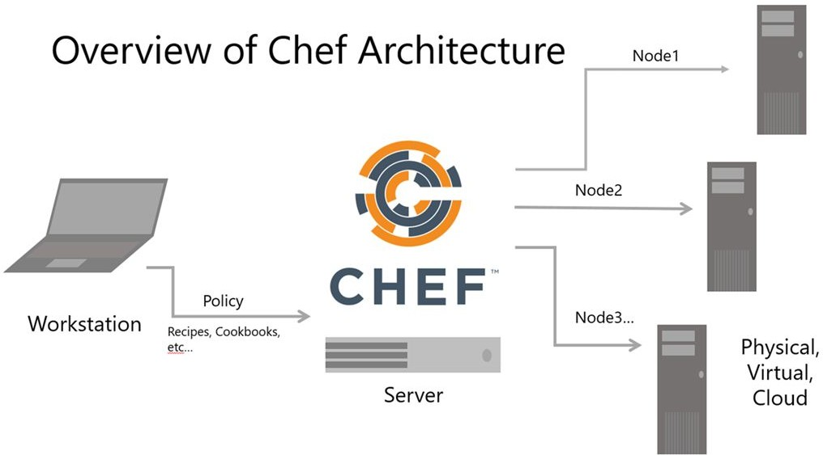
Configuration management - architecture
Source:
https://blogs.msdn.microsoft.com/uk_faculty_connection/2016/06/29/solving-configuration-management-obstacles-with-chef/

Slide 60
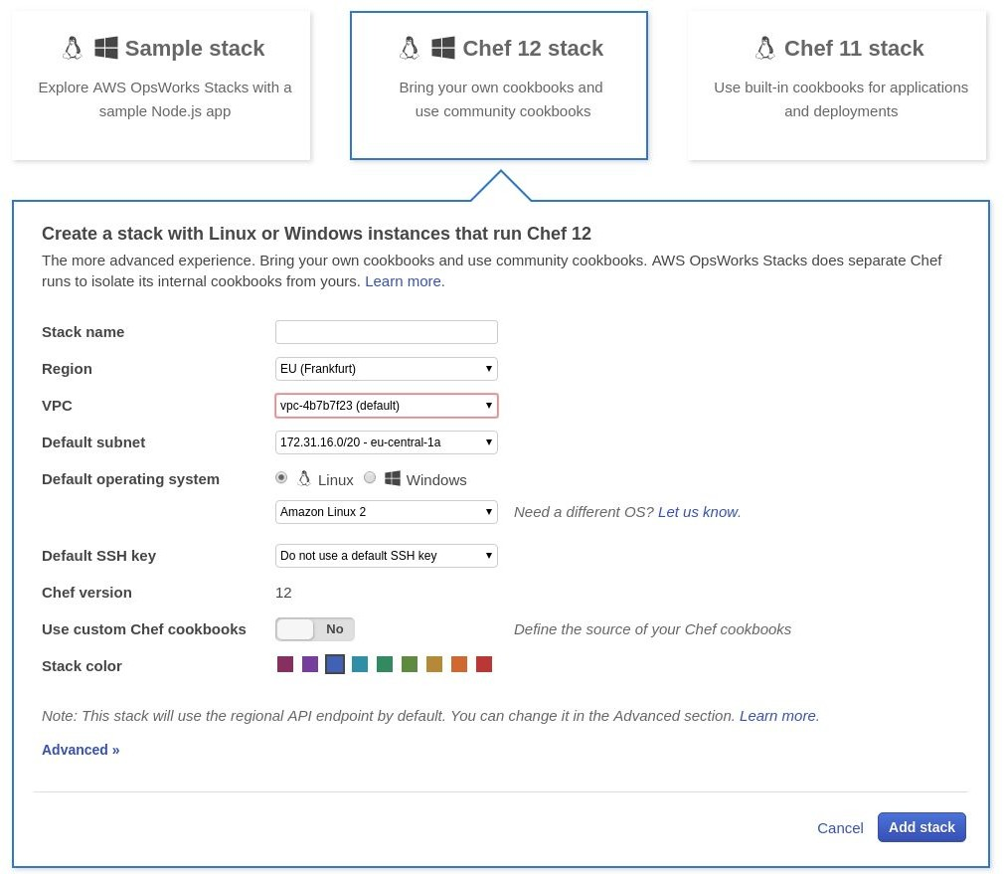
AWS OpsWorks
Chef solo (localhost) or Puppet Enterpris
CloudFormation in the backend
Can be provisioned via Terraform (yay!)
Autoscaling using Lambda Hacks
AWS console - let’s see how this looks
e

Slide 61
HashiCorp Vault
Key-value secret storage
Encrypt secrets at rest (storage) and at transfer (https)
Takes care of invalidating old secrets (API keys rotation)
Versioning of the key-value storage is also possible
One-time secrets
“Cubbyhole” secrets wrapping
Possible to integrate with Terraform (yay!)
… and more

Slide 62
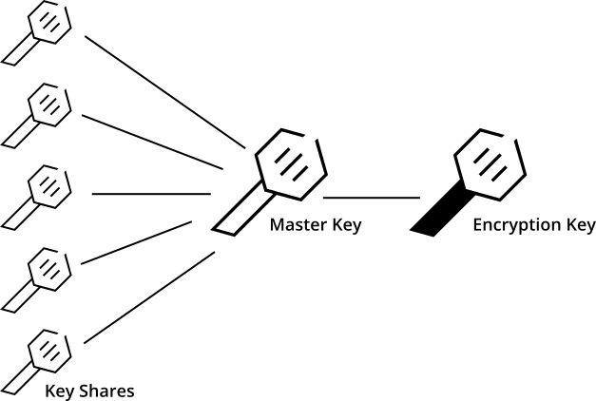
HashiCorp Vault - seal/unseal
default (key)
AWS KMS
Azure Key Vault
GCP Cloud KMS

Slide 63
HashiCorp Vault - authentication
Username and password
GitHub (token actually)
AWS IAM
LDAP
Radius
Tokens
https://www.vaultproject.io/docs/auth/index.html

Slide 64
HashiCorp Vault - testing locally
$ vault server -dev
$ export VAULT_ADDR='http://127.0.0.1:8200'
$ vault status
Already unsealed
In-memory data store
Good for testing
Do NOT use in production

Slide 65
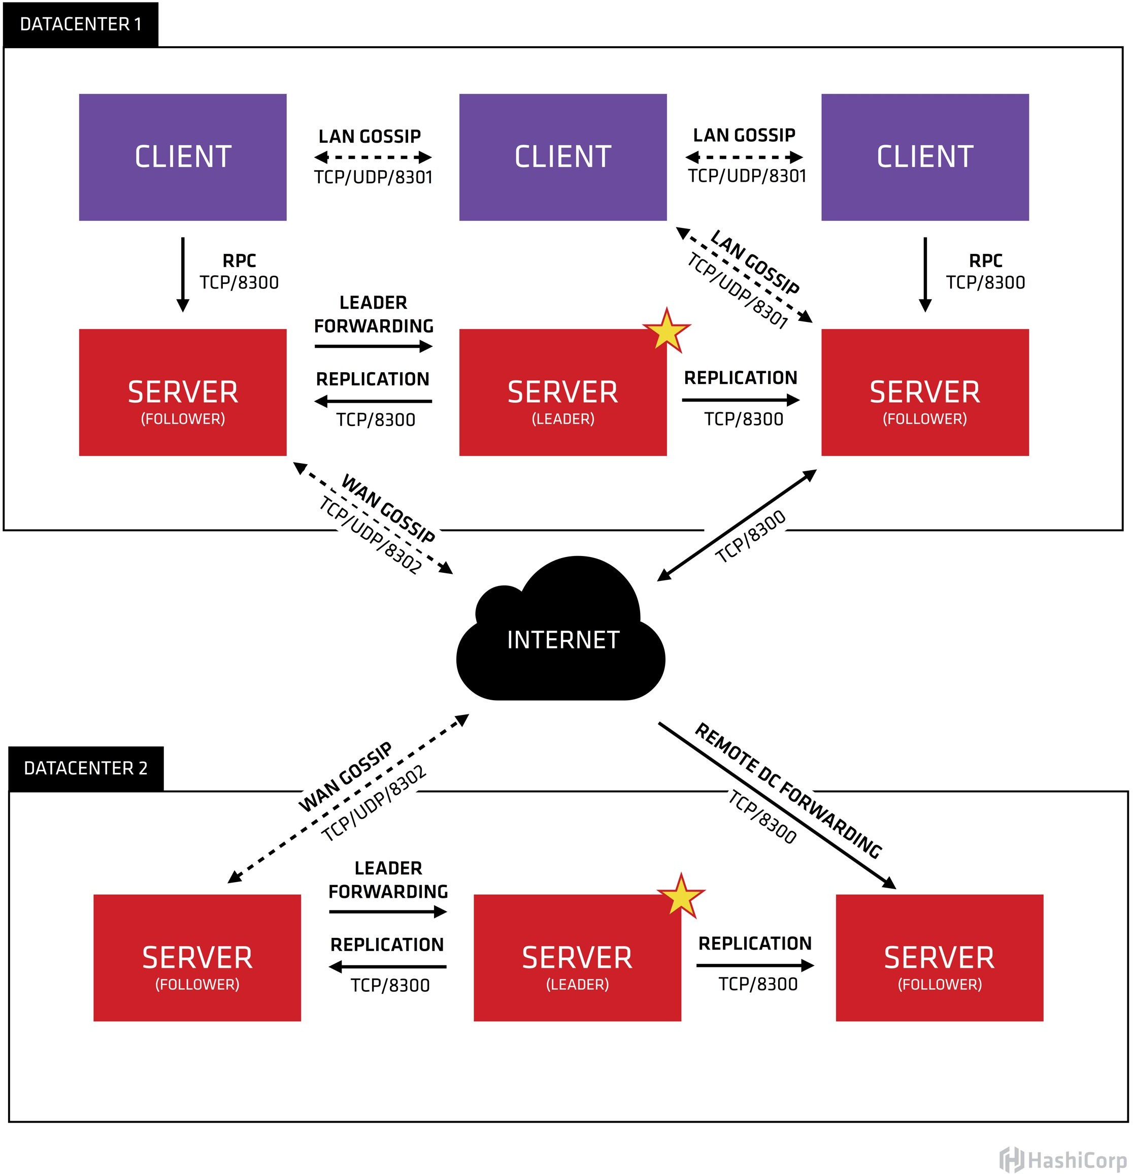
HashiCorp Consul - service discovery and more
Source: https://www.consul.io/docs/internals/architecture.html

Slide 66
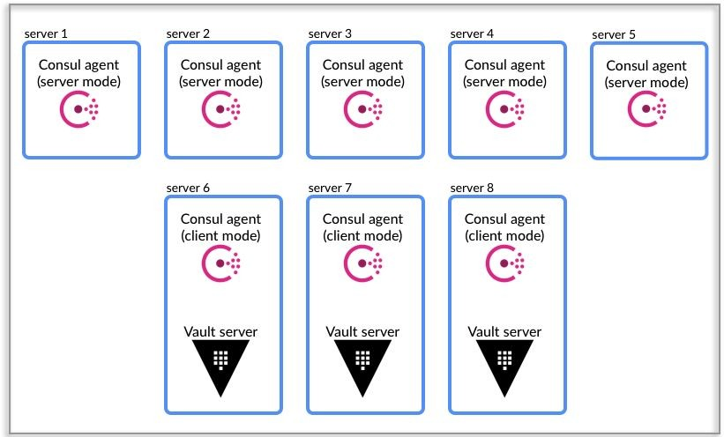
HashiCorp Vault and Consul as a backend
Source: https://www.consul.io/docs/internals/architecture.html

Slide 67
HashiCorp Vault + Consul - setting up Consul
{
"acl_datacenter": "dev1", "server": true, "datacenter": "dev1",
"data_dir": "/var/lib/consul", "disable_anonymous_signature": true, "disable_remote_exec": true, "encrypt": "Owpx3FUSQPGswEAeIhcrFQ==", "log_level": "DEBUG",
"enable_syslog": true, "start_join": ["192.168.33.10",
"192.168.33.20", "192.168.33.30"],
"services": []
}
# consul agent -server \
-bootstrap-expect=1 -data-dir \
/var/lib/consul/data \
-bind=192.168.33.10 \
-enable-script-checks=true \
-config-dir=/etc/consul/bootstrap
CTRL+C when done
# servicectl start consul

Slide 68
HashiCorp Vault + Consul - connecting Vault
# vault server -config=/etc/vault/vault.hcl
backend "consul" {
address = "127.0.0.1:8500"
path = "vault"
}
listener "tcp" {
address = "127.0.0.1:8200"
tls_disable = "1"
}

Slide 69
HashiCorp Vault + Consul - init
$ vault init -tls-skip-verify
Unseal | Key | 1: | sahg1Y48nQ4fAzfzCM6UN8d9RTB+uqJiu0/HsQxr+CDF
Unseal | Key | 2: | tGk1p191YACXyhJ/SHjRjnGYw1zMLGapAuJ40zMX4qT7
Unseal | Key | 3: | J/ZgUCosSnr2VRP803aBX+UMRK6lfQU2gmZ98yIFbxOu
Unseal | Key | 4: | y6j8nwL/VHNwOgL80HFf89ztPEB06POetitLf6ndrL59
Unseal | Key | 5: | 7TiRQ/F4An6wMrjX6k1Qe8VGUwyYpTawcXHdMkNg7aNH
Initial Root Token: s.7DGCNrZsF2gbIK9BMRLWymZp

Slide 70
HashiCorp Vault + Consul - unseal
# vault operator unseal -tls-skip-verify
Unseal Key (will be hidden):Key Value
Seal Type Initialized Sealed
Total Shares Threshold Unseal Progress Unseal Nonce Version
HA Enabled
shamir true true
5
3
⅓
36bba3e0-8ac6-b2e6-80a3-cfe3cbd0202c 1.0.0
true

Slide 71
HashiCorp Vault - first secret
[vagrant@vault-01 ~]$ vault kv put secret/hello foo=world
Key
---
created_time deletion_time destroyed version
Value
-----
2018-12-12T11:50:21.722423496Z
n/a false 1

Slide 72
HashiCorp Vault - get secret
[vagrant@vault-01 ~]$ vault kv get secret/hello
====== Metadata ======
Key
---
created_time deletion_time destroyed version
Value
-----
2018-12-12T11:50:21.722423496Z
n/a false 1
=== Data ===
Key
---
foo
Value
-----
world
[vagrant@vault-01 ~]$ vault kv get -format=json secret/hello

Slide 73
HashiCorp Vault - token create
[vagrant@vault-01 ~]$ vault token create
Key
---
token token_accessor token_duration token_renewable token_policies identity_policies policies
Value
-----
s.4fQYZpivxLRZVYGhjpTQm1Ob XYOqtACs0aatIkUBgAcI6qID
∞ false
["root"] []
["root"]

Slide 74
HashiCorp Vault - login using token
[vagrant@vault-01 ~]$ vault login s.hAnm1Oj9YYoDtxkqQVkLyxr7
Success! You are now authenticated. The token information displayed below is already stored in the token helper. You do NOT need to run "vault login" again. Future Vault requests will automatically use this token.
Key
---
token token_accessor token_duration token_renewable token_policies identity_policies policies
Value
-----
s.hAnm1Oj9YYoDtxkqQVkLyxr7 6bPASelFhdZ2ClSzwfq31Ucr
∞ false
["root"] []
["root"]

Slide 75
HashiCorp Vault - token revoke
[vagrant@vault-01 ~]$ vault token revoke s.6WYXXVRPNmEKfaXfnyAjcMsR
Success! Revoked token (if it existed)
See more on auth: https://learn.hashicorp.com/vault/getting-started/authentication

Slide 76
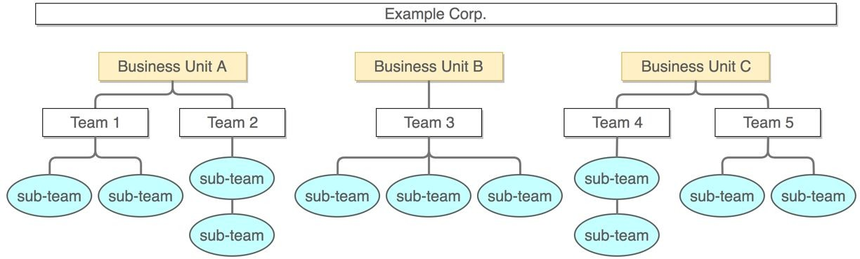
HashiCorp Vault - multi-tenant
Source: https://learn.hashicorp.com/vault/operations/namespaces

Slide 77
HashiCorp Vault - multi-tenant - exercises
Let’s create two namespaces
Create policies for the namespaces
Create a few secrets in each
Create one user in each
Test if users have access to their own namespaces

Slide 78
Databases in AWS - quick introduction
Aurora
RDS
DynamoDB
Elasticsearch + Kibana
ElastiCache (Memcache, Redis)

Slide 79
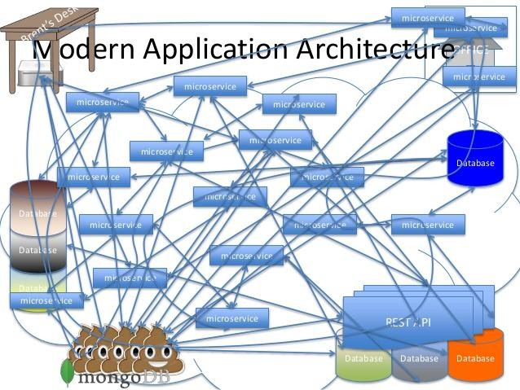
AWS Lambda and Serverless
http://www.slideshare.net/danveloper/microservices-the-right-way

Slide 80
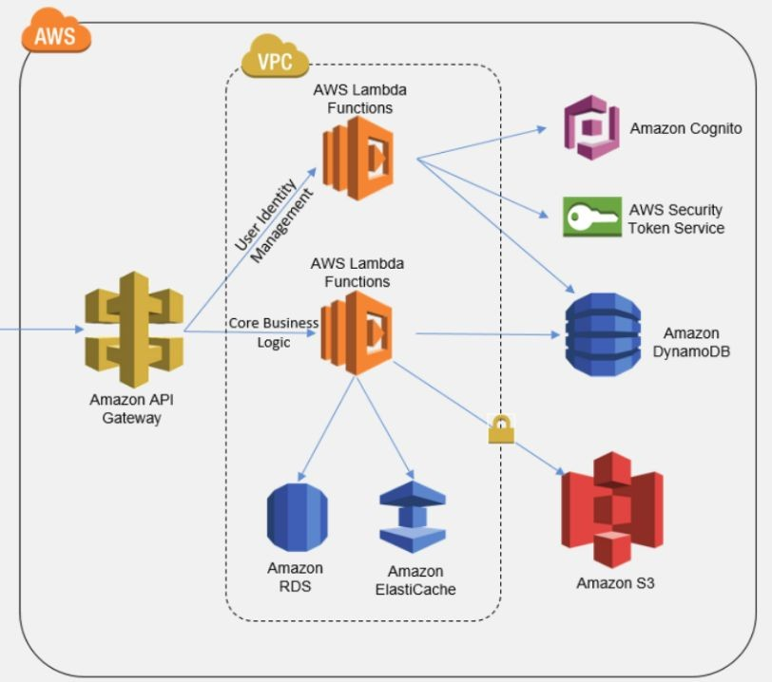
AWS Lambda and Serverless
Actually it’s more mixed and also complex
Layered architecture (think MVC) + Event-driven (ESB, but not that heavy)
In a Docker
… or as lambdas
https://www.fiverr.com/natasha_bab/setup-cloud-based-backend-for-mobile-n-web

Slide 81
AWS Lambda and Serverless

Slide 82
AWS Lambda and Serverless
There’s no “server less”
Using VPC slows things down
Utilize SaaS provided by the AWS (SQS, SNS, DynamoDB, CloudWatch, X-Ray)
Mind Lambda limitations (memory, cpu, execution time)
Big packages tend to run slower, keep it simple
Workflows or long running with step functions

Slide 83
Let’s create a function
Python
IAM role allowing interacting with Autoscaling
Function will increase instances by one
Manual trigger
Setup using Terraform
Code upload using AWSCLI (Bash/Makefile)

Slide 84
Side quest: Vault + Consul in AWS
Use Terraform and an Autoscaling Group/Launch Configuration to set up Consul hosts - manual cluster set up, for simplicity
Alternatively, use ECS cluster and public Conul image https://hub.docker.com/_/consul/
Same for Vault
(Re)use Python service to grab configuration key/values from Vault

